Slide 1
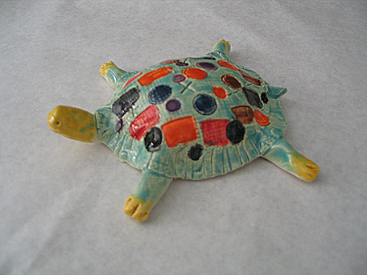
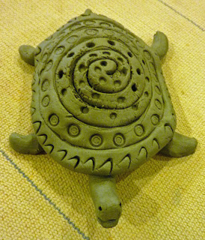
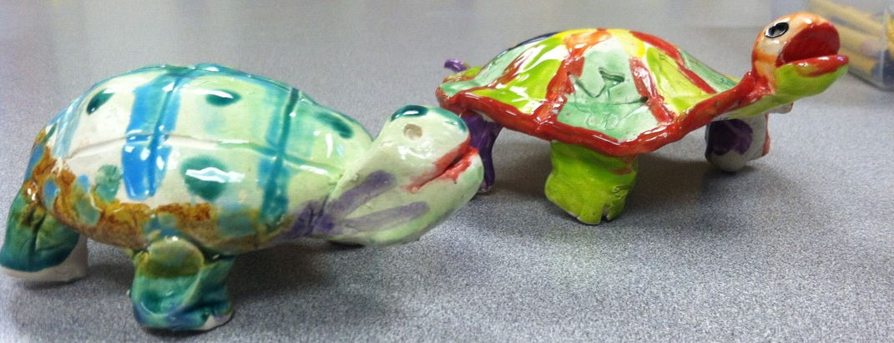
Pinch Pot Turtles

Slide 2
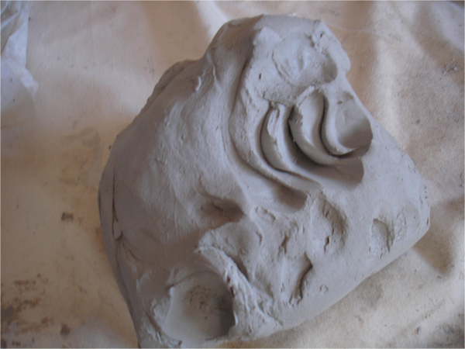
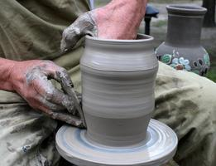
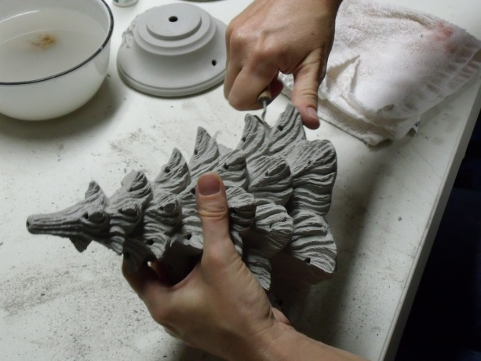
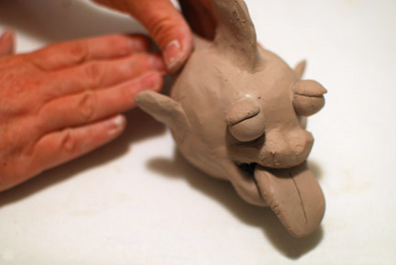
How do we work with it?
Plastic Stage
Workable
Moldable

Slide 3
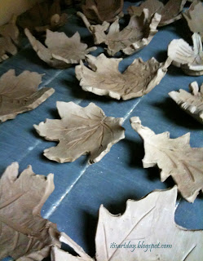
Greenware Stage
Wet
Damp
Leather-hard
Bone dry
Once it is dry and light gray it becomes very fragile

Slide 4
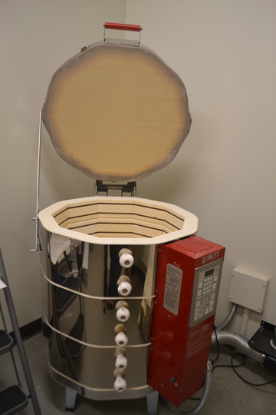
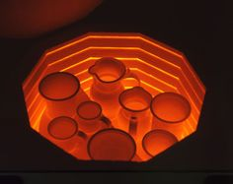
Electric Kiln
1800 -2000 degrees F

Slide 5
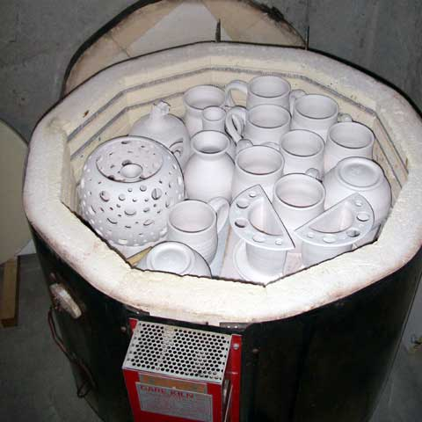
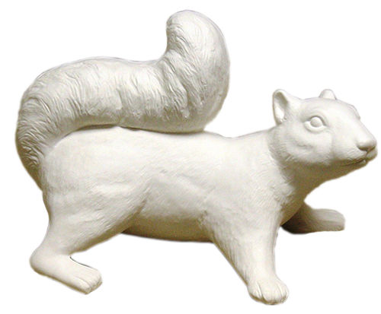
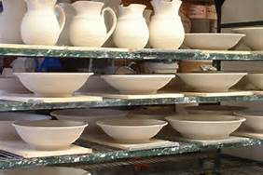
Bisqueware Stage
After fired in the kiln
Does not break that easily
The grey clay turns white

Slide 6
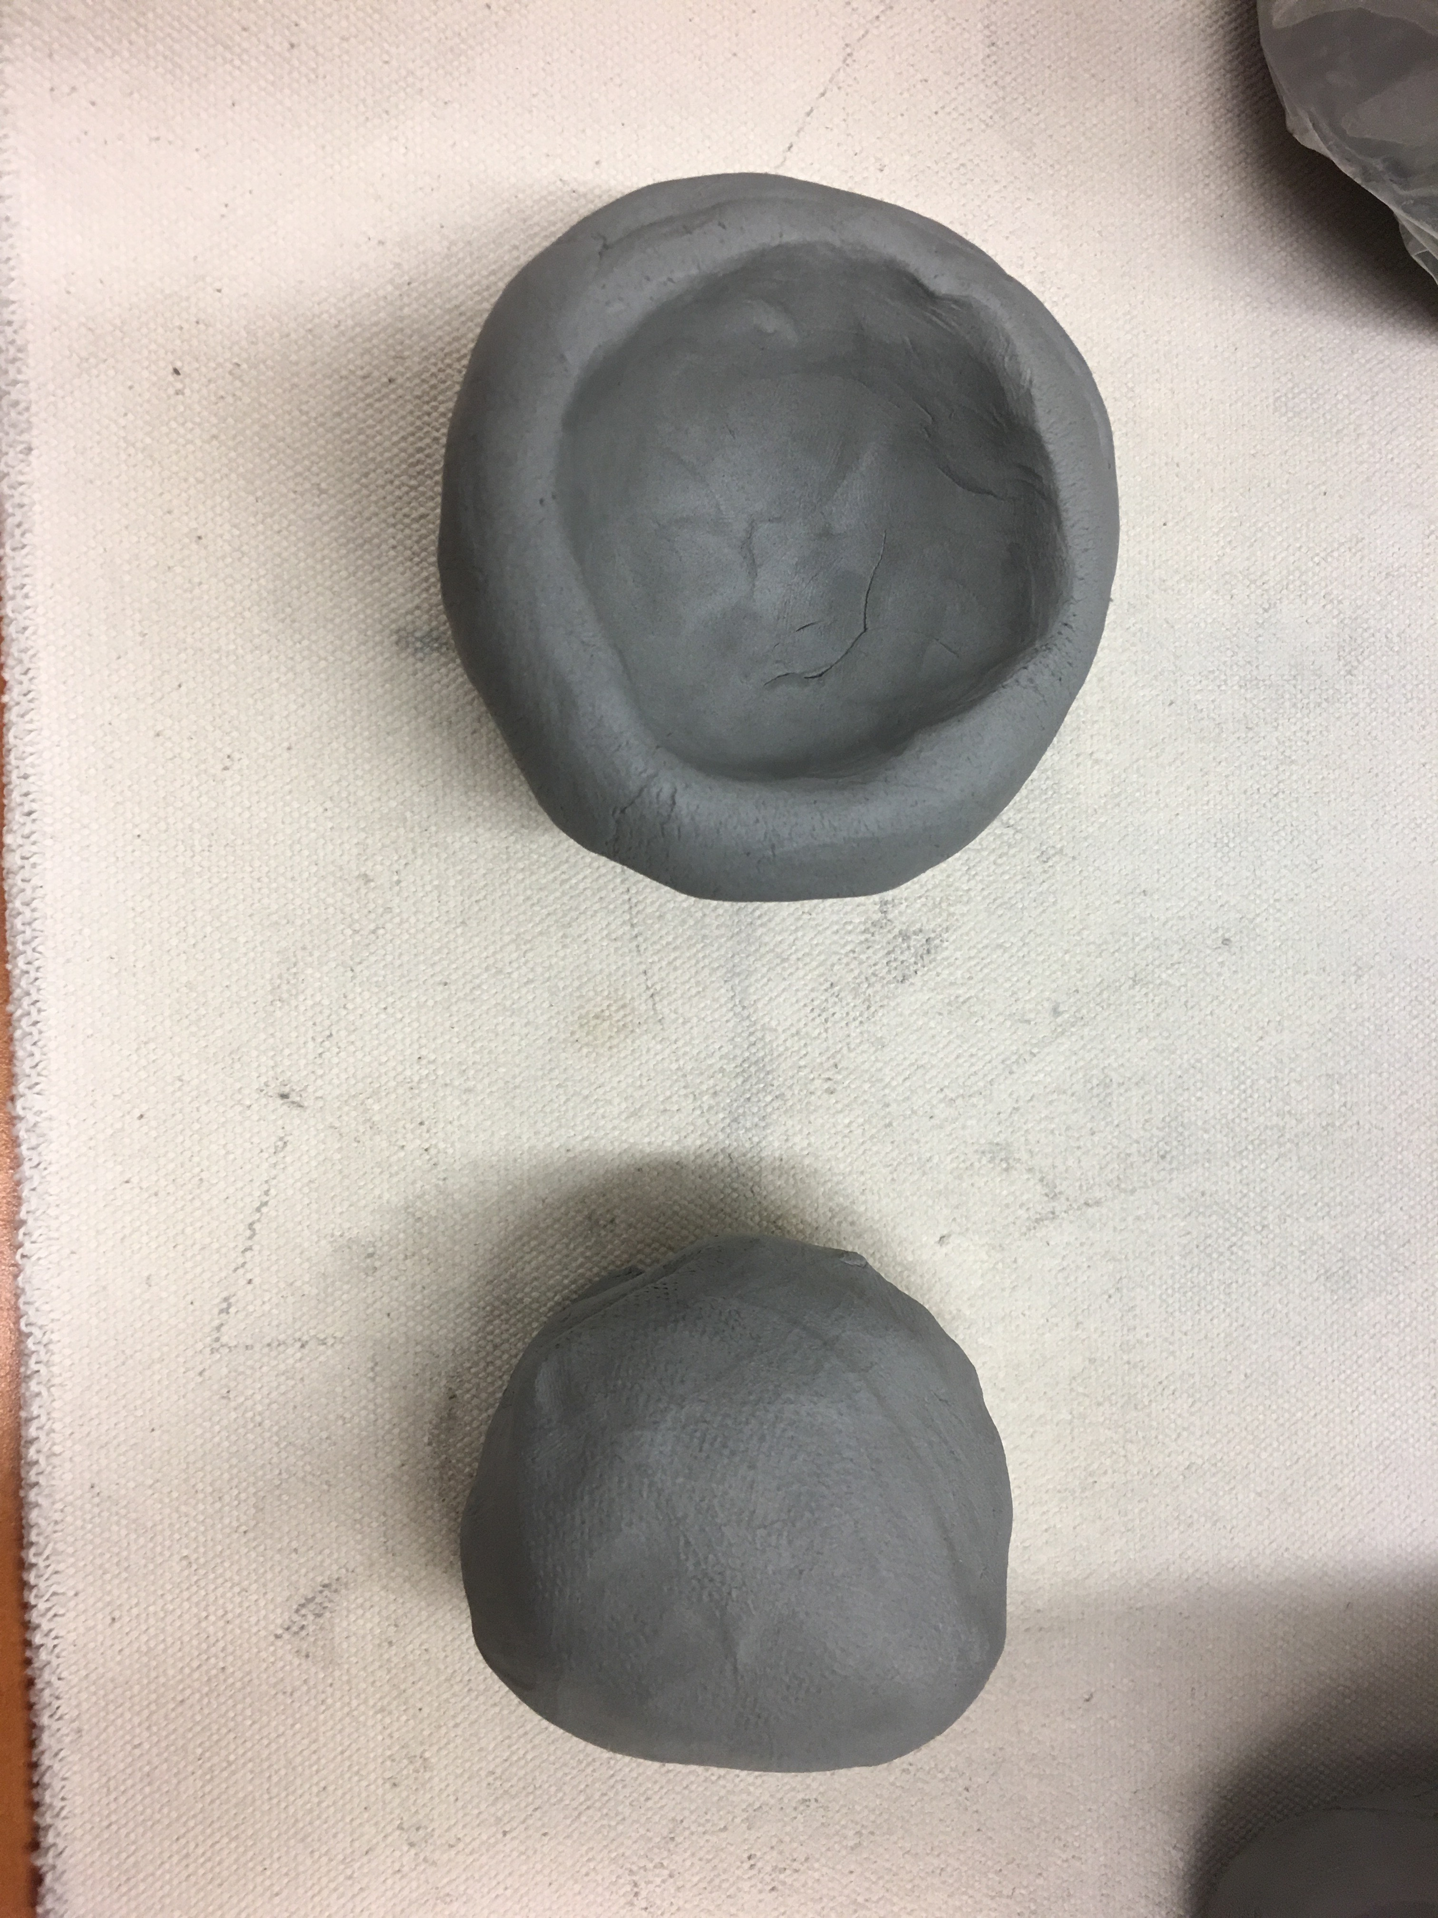
Start by shaping your clay a little. Roll the chunk between your hands or against your work surface to form a ball.
Create an opening. Cup the ball in your hand. Next, gently press your thumb into the center of the ball to create an opening. Leave at least ½ of an inch of clay at the bottom. If you accidentally pinch through the base of the pot, roll the clay into a ball again and start over.
This is a video→

Slide 7
Pinch the pot. Use gentle pinching motions to thin out the walls of the pot. Work in circles to thin out the sides at the same rate. Keep pinching until the walls are as thin as you’d like them. The walls of the pot should be similar in thickness without any large divots. Smooth out any cracks in the clay with your fingers after you’ve finished forming the pot.
←This is a video

Slide 8
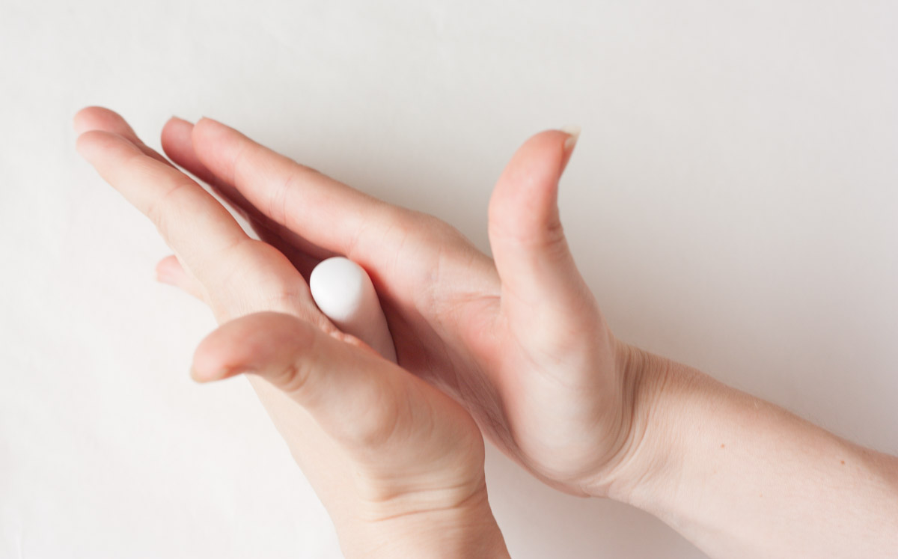
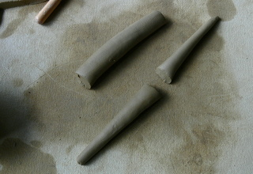
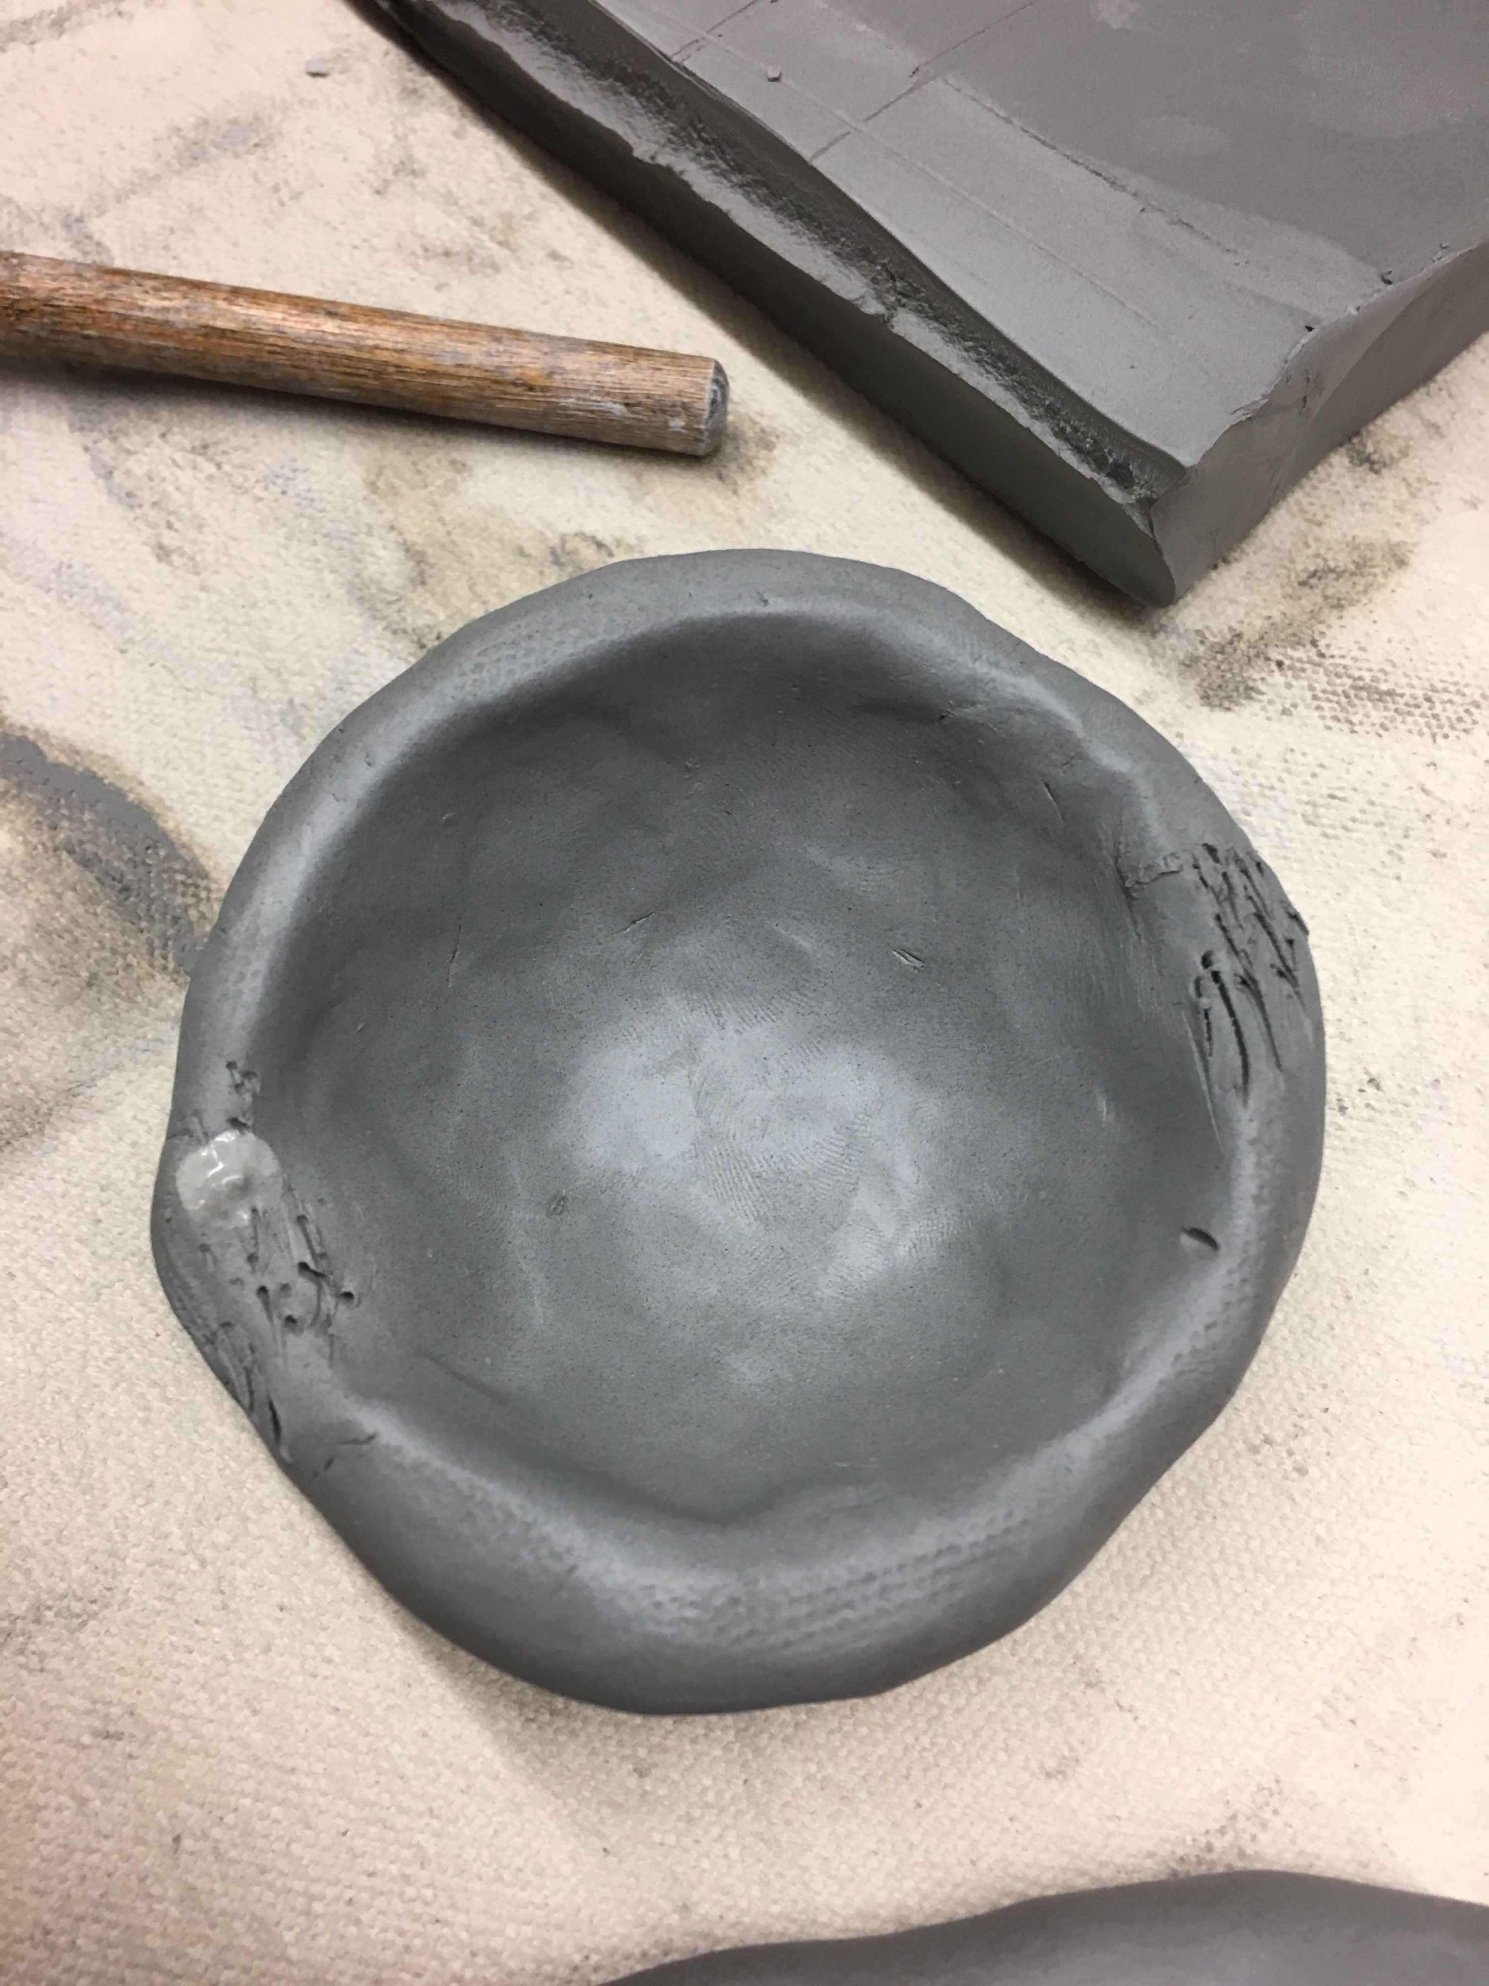
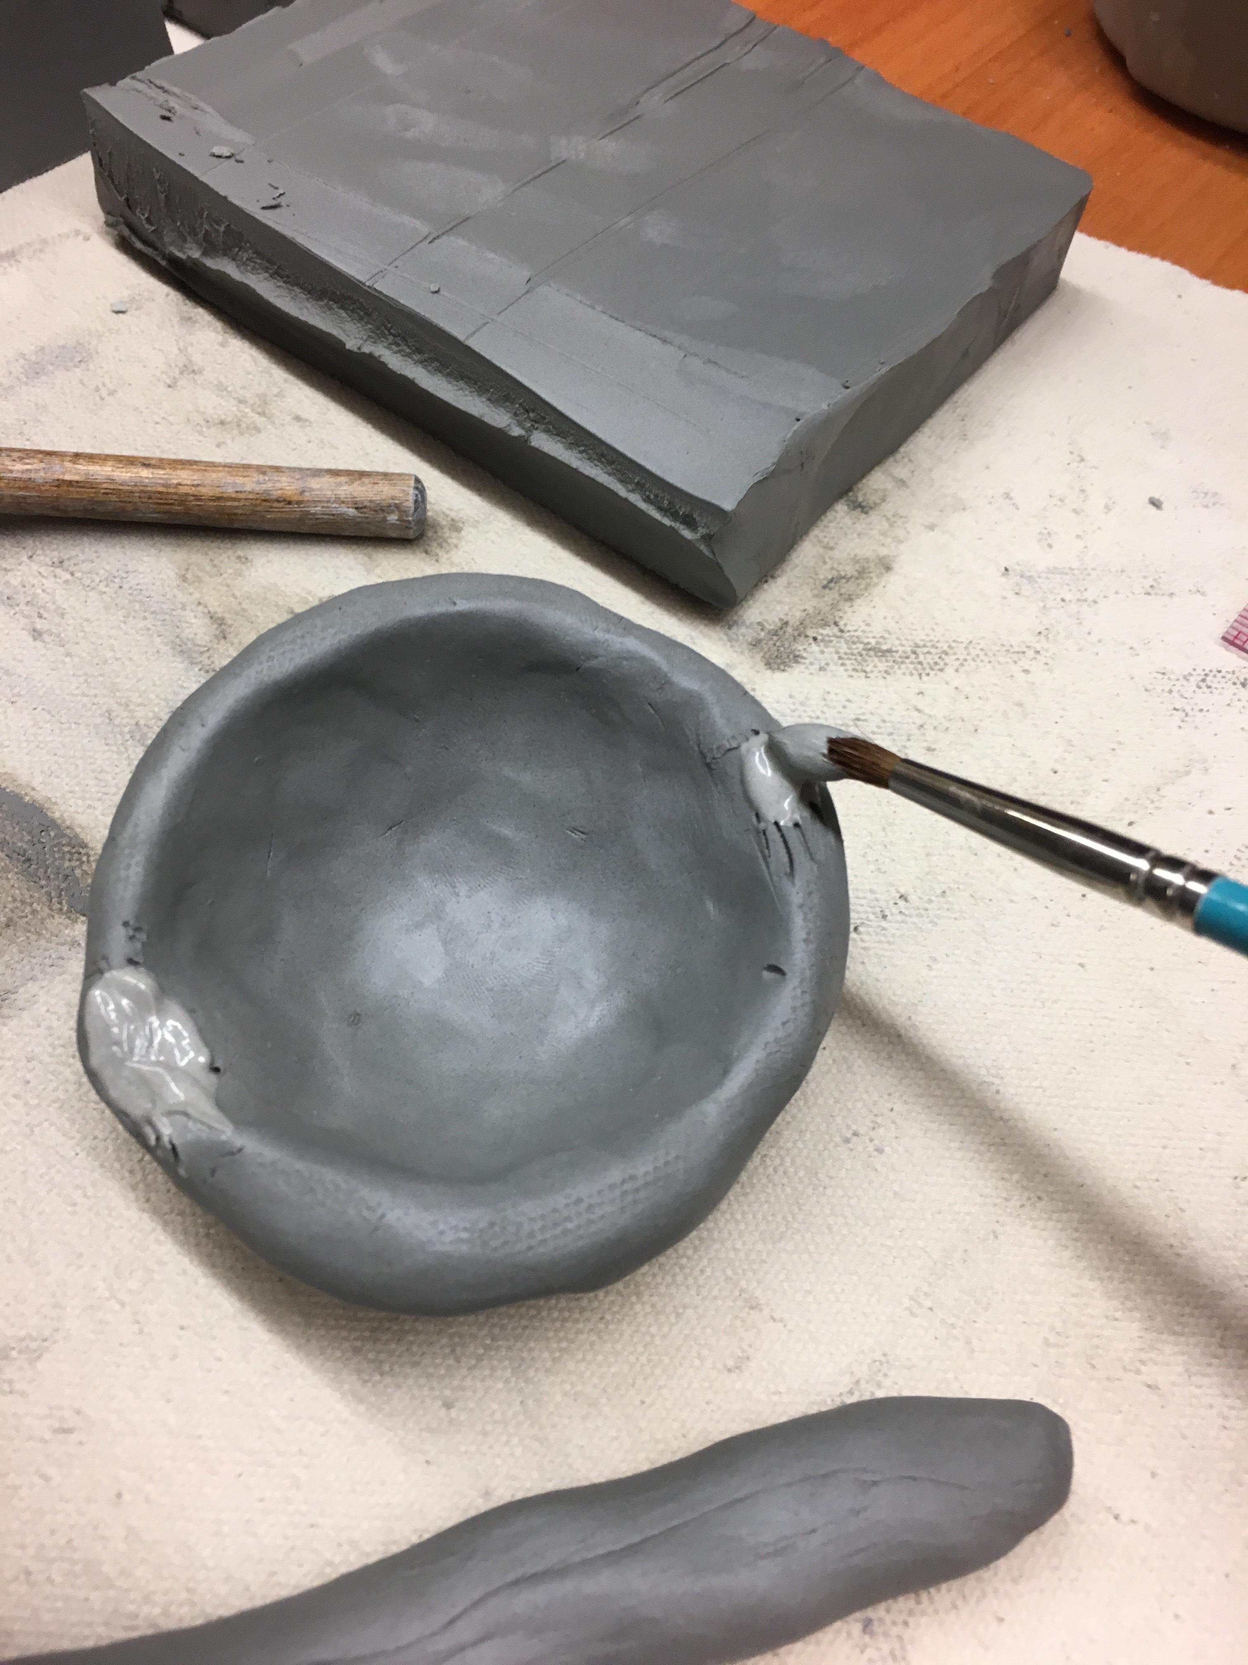
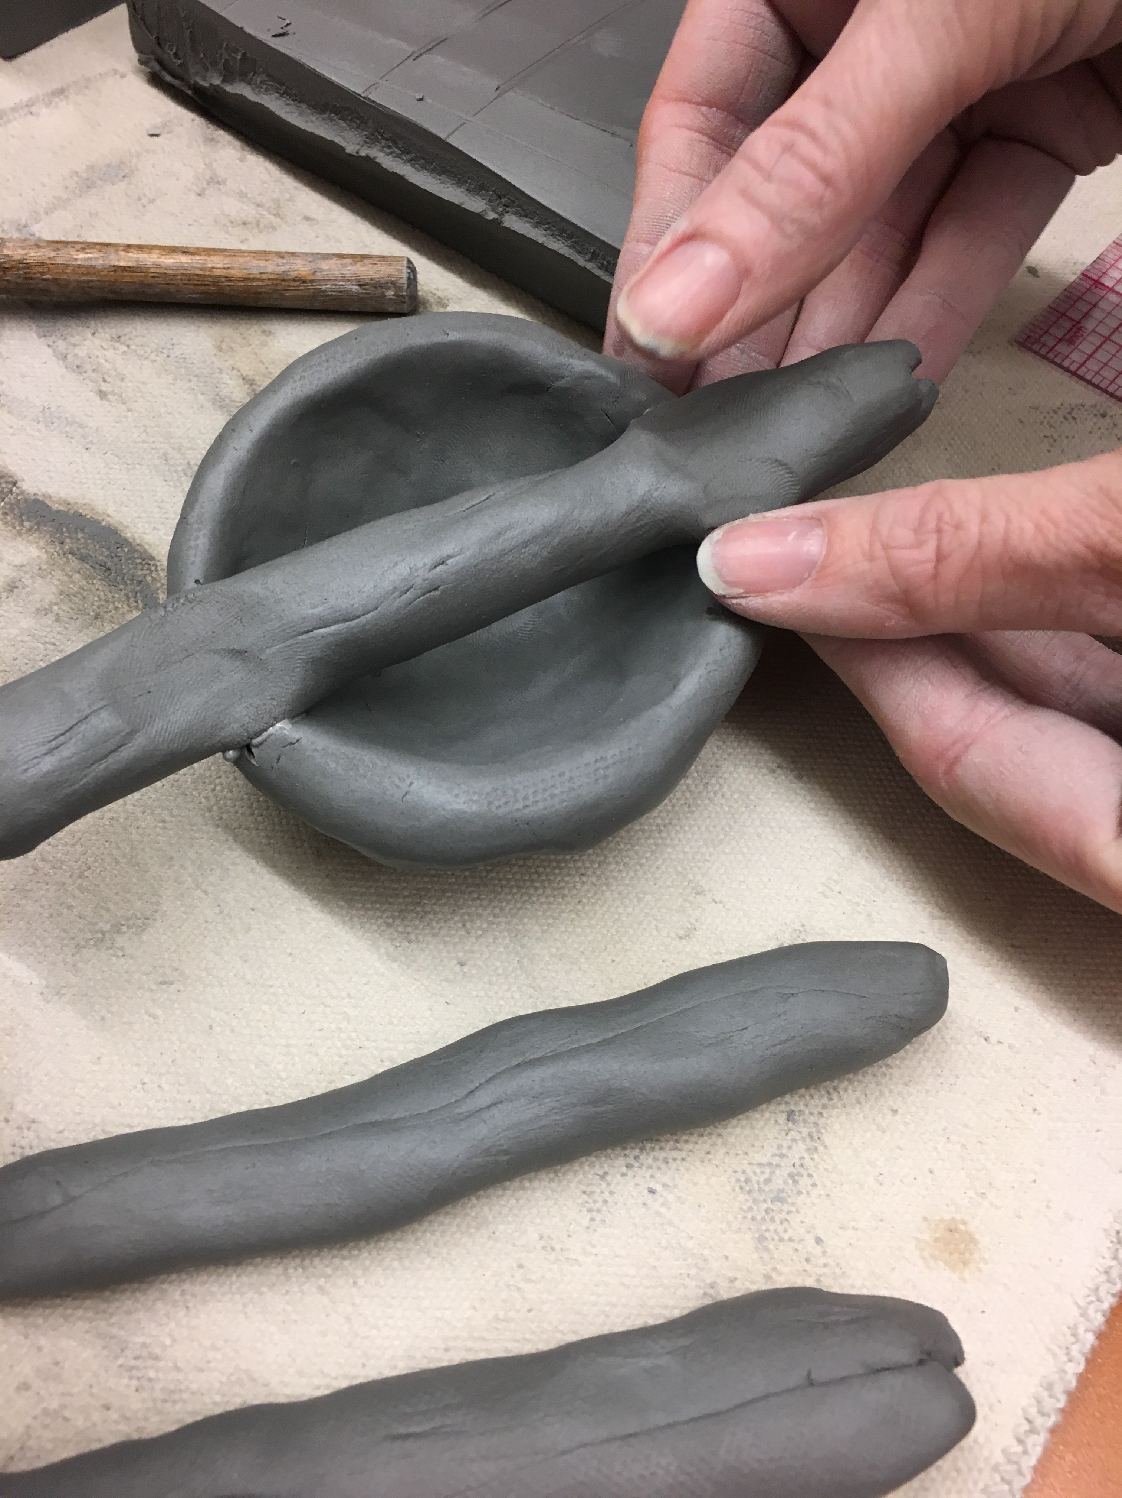
Take 3 smaller lumps of clay and roll each into a log.
Attach one log for the body (head and tail). Remember to scratch the area you want to attach to and then add some “glue” (also called slip).

Slide 9
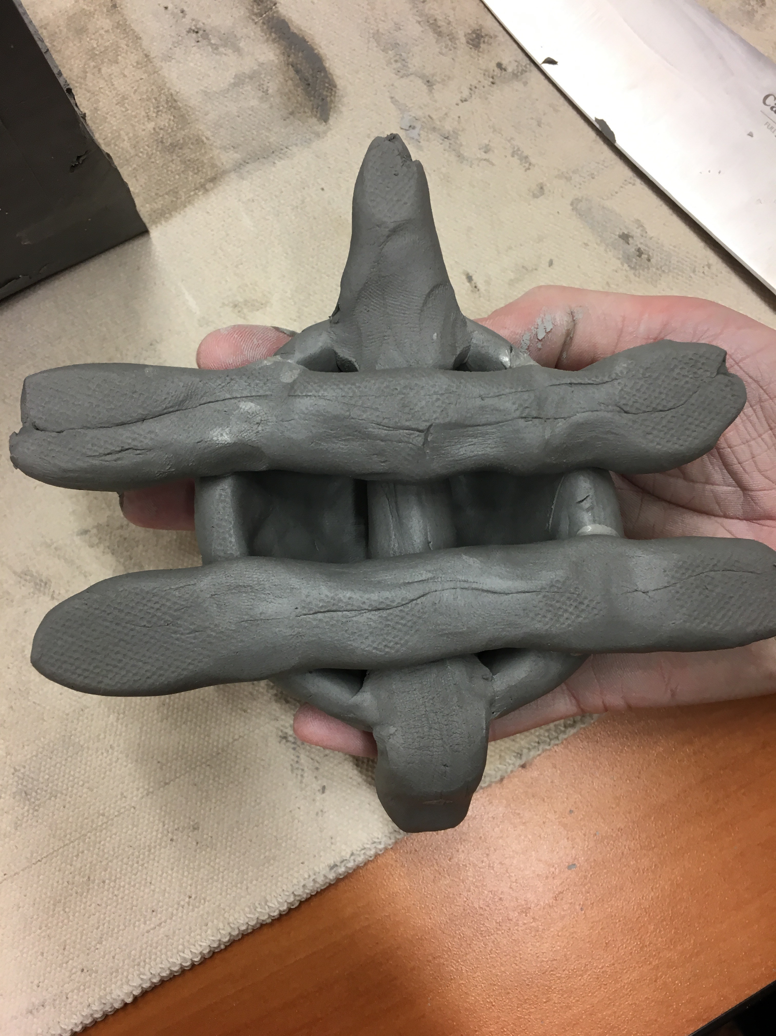
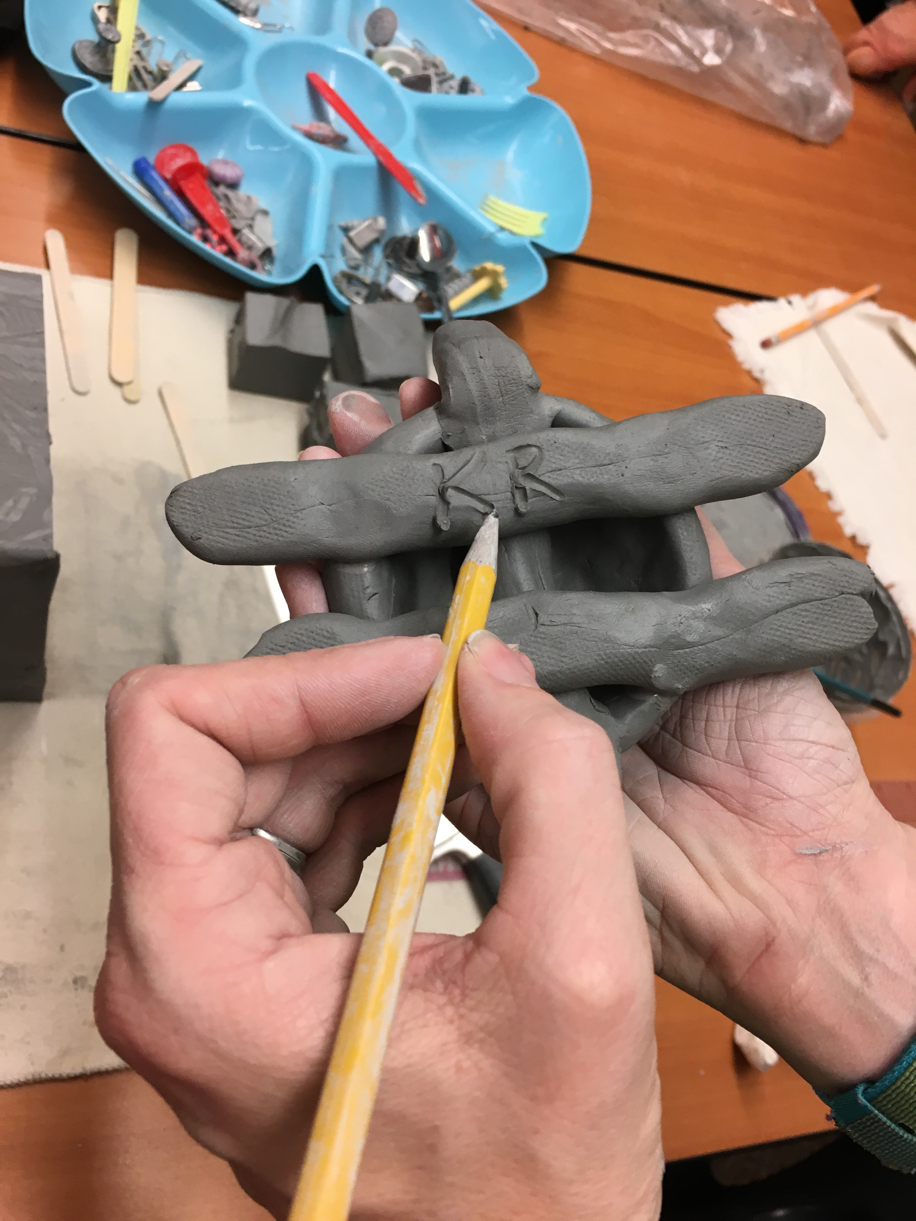
Then attach the legs. Use the same method where you scratch and apply “glue”.
Write your name or initials (adults can help with this step).

Slide 10
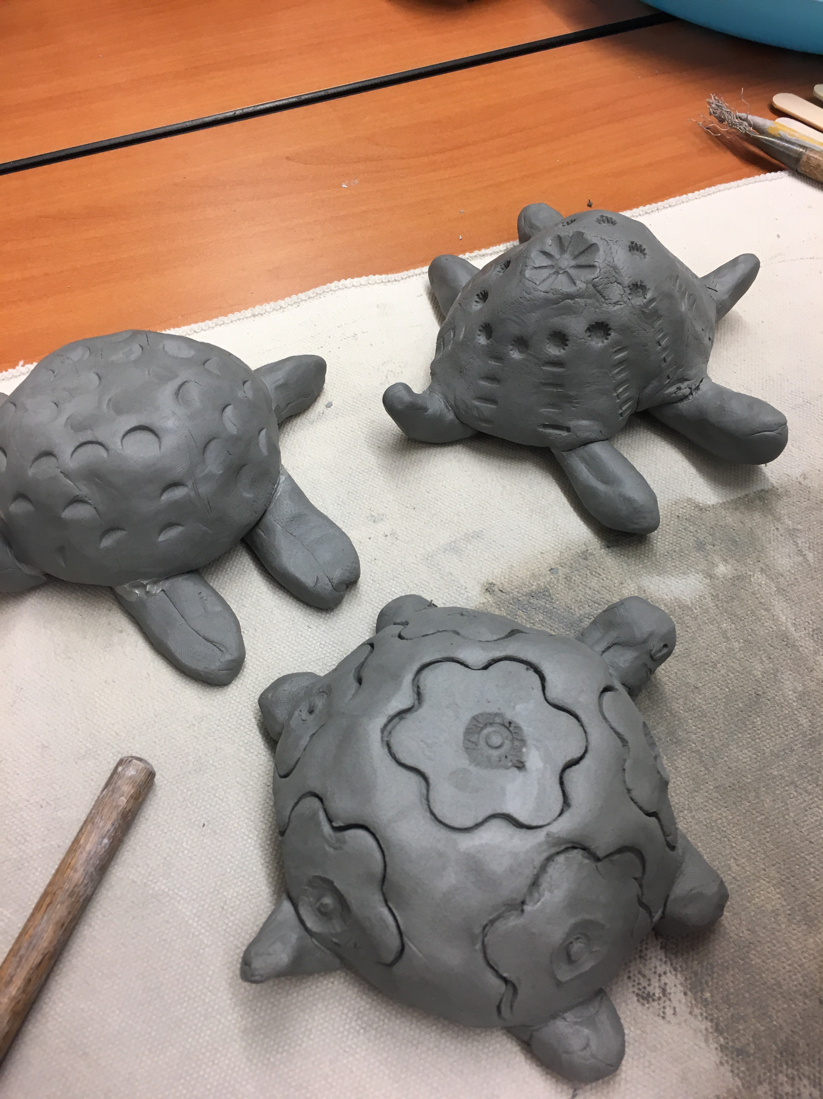
Flip over, shape head, tail, and legs.
Add texture to shell.

Slide 11
Next time…
We will paint the projects with something called GLAZE which is a special liquid like a paint that’s made of bits of ground up glass. Then they will be fired in the kiln again.

